Slide 1
Comparison of Villages in Newton, MA, U.S.A.

Slide 2
Outline
Introduction
How data science can help?
Data Results
Foursquare venues
Housing price data
Crime data
Summary and Recommendation

Slide 3
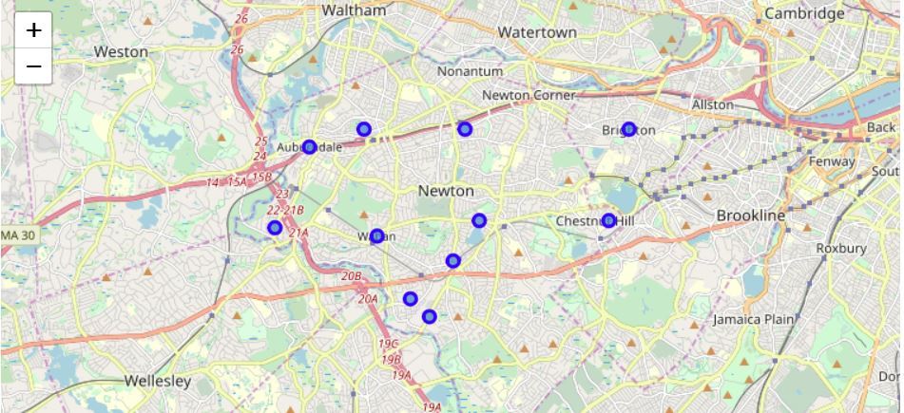
Introduction
The town of Newton, MA has 11 neighborhoods (also known as villages)
How can a family chose a village to move to?

Slide 4
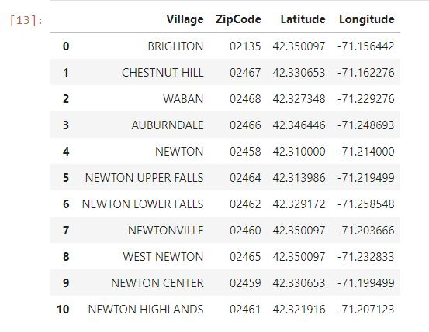
List of Villages in Newton, MA

Slide 5
How can data science help?
Foursquare venue data -> cluster similar villages together
Redfin housing data -> comparison of house price in each zip code
Newton Police incident report -> comparison of crime in different neighborhood

Slide 6
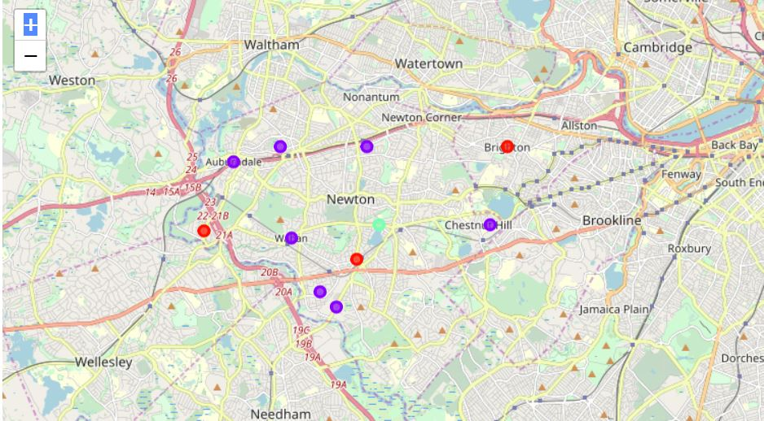
Foursquare Data
Using K-mean clustering, the 11 villages were divided into three clusters using Fourquare’s venue data

Slide 7
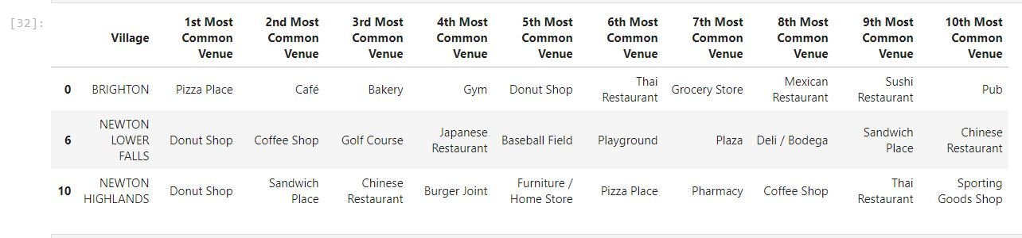
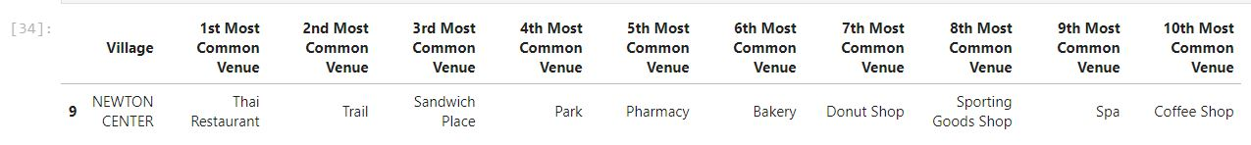
Cluster information
This cluster of villages is most appropriate for family who likes eating out.

Slide 8
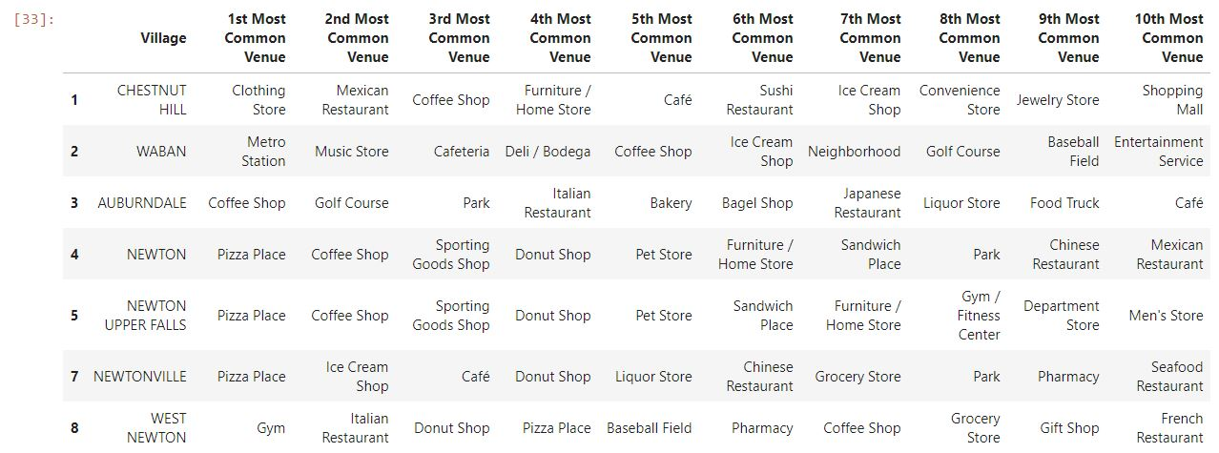
Cluster Information (cont.)
This cluster of villages is most appropriate for family with kids

Slide 9
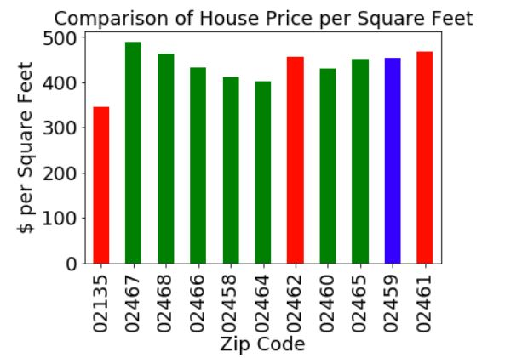
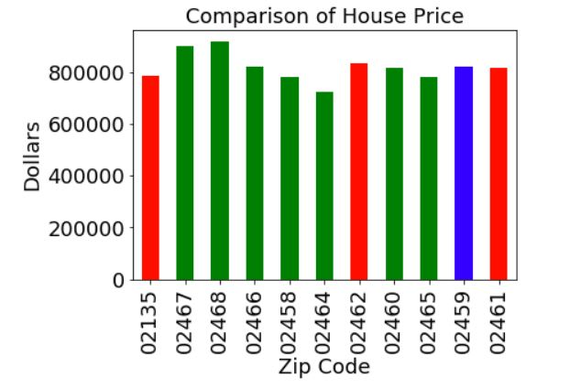
Housing Data
Average house price (total cost as well as per square feet) for single house sold
in the last three years.
Each color indicates a cluster.

Slide 10
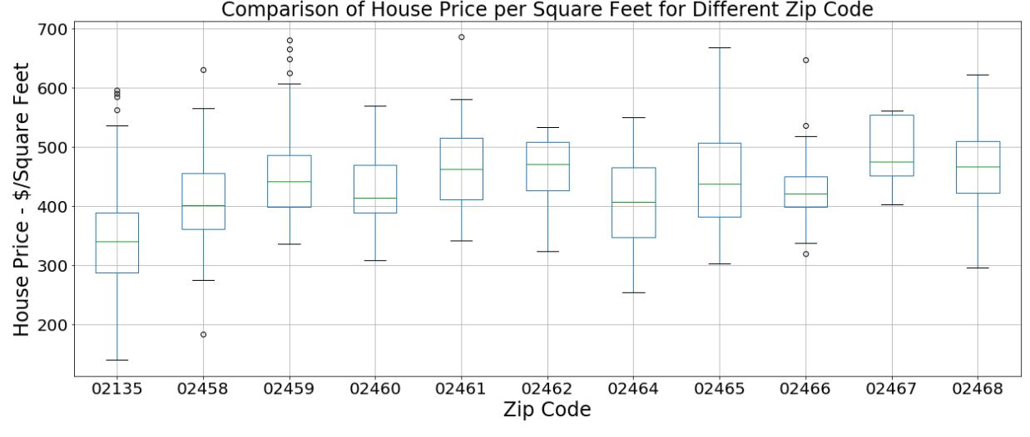
Housing Data (cont.)

Slide 11
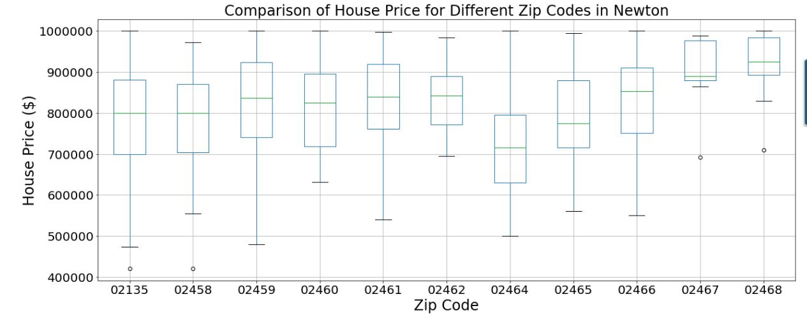
Housing Data (cont.)

Slide 12
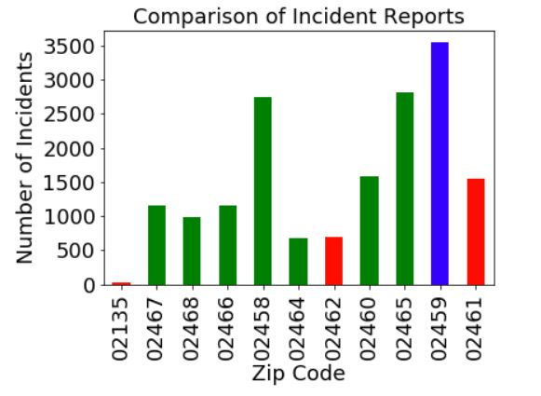
Crime Data

Slide 13
Summary
There are three clusters of villages in Newton
Housing data show that Newton Upper Falls, 02464, has the lowest house price.
Crime data indicate that Brighton is the safest while Newton Center (02459) is worst.

